Slide 1
Intelligent Navigation Systems Using Deep Computer Vision
Institute of Systems Science, National University of Singapore
MTech(IS)
Intelligent Robotics Systems
Practice Module

Slide 2

Team Members
Institute of Systems Science, National University of Singapore
TAN CHIN GEE – A0195296M
GENG LIANGYU – A0195278M
HAN DONGCHOU FRANCIS – A0195414A

Slide 3
Project Source
Institute of Systems Science, National University of Singapore
Research Paper
R. Bonatti, R. Madaan, V. Vineet, S. Scherer, and A. Kapoor, “Learning visuomotor policies for aerial navigation using cross-modal representations,” arXiv preprint arXiv:1909.06993, 2020.
Codes & Dataset
https://github.com/microsoft/AirSim-Drone-Racing-VAE-Imitation
Supplementary Video
https://www.youtube.com/watch?v=VKc3A5HlUU8&feature=youtu.be

Slide 4
Project Source
Institute of Systems Science, National University of Singapore
Simulation Platform
S. Shah, D. Dey, C. Lovett, and A. Kapoor, “Airsim: High-fidelity visual and physical simulation for autonomous vehicles,” Field and Service Robotics, 2017. [Online]. Available: https://arxiv.org/abs/1705.05065
Codes & Documentation
https://microsoft.github.io/AirSim/

Slide 5
Overview
Institute of Systems Science, National University of Singapore
Simulated environments are often a viable strategy for the research and development of intelligent vehicular navigation systems [3].
Businesses and researchers can reap several benefits from using simulation such as:
savings on cost & time,
(b) ease of collecting a large amount of annotated training data, and
(c) flexibility in changing the training environment on the fly [2].
However discrepancies between simulated and real environments, such as lighting conditions, can degrade navigation performance of autonomous vehicles in real scenarios. This is termed as the reality gap problem [4].

Slide 6
Overview
Institute of Systems Science, National University of Singapore
One method to address the reality gap problem focuses on learning a rich low-dimensional representation of two modality of simulated perceptual data [1].
The two data modality are:
Images from a monocular RGB camera (first-person view images)
Navigation markers’ (gates used in drone racing) position and orientation relative to the vehicle
Cross Modal-Variational AutoEncoder (CM-VAE) encodes essential visual elements from both data modality, which facilitates implicit regularization of the latent representation, which is the key for bridging the reality gap.
Results showed that control policy trained on the CM-VAE latent representation in simulated environment generalizes well to real scenarios.

Slide 7
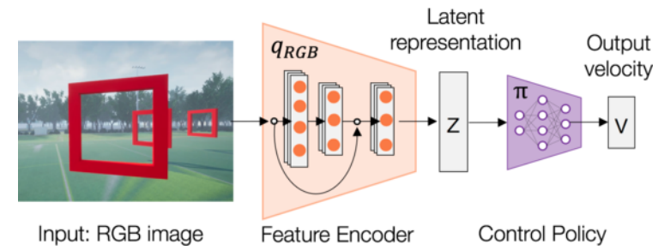
Overview
Institute of Systems Science, National University of Singapore
The intelligent vehicular navigation system comprises two modules [1].
Perception: learn a low-dimensional representation of simulated perception data captured by a monocular RGB camera
Control: train a control policy using the learned representation, z
Image taken from [1]

Slide 8
General Architecture
Institute of Systems Science, National University of Singapore
Hypothesis – Increasing the accuracy of image classification performed by the CM-VAE encoder [1] will lead to latent representation that generalizes better to real scenarios.
Approach – Enhance the Feature Encoder [1] by replacing its ResNet layers [5] with:
DenseNet [6] and/or,
HRNet [7].
Image taken from [1]

Slide 9
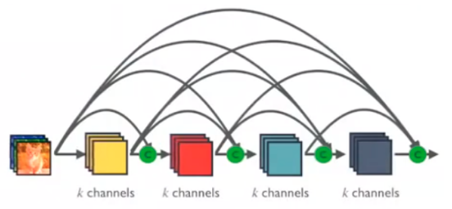
General Architecture
Institute of Systems Science, National University of Singapore
DenseNet [6]
A dense block of the DenseNet illustrates our proposed architecture
Each layer will initially have this specified composition:
Batch Norm
ReLU
3 x 3 Convolution
Number of channels, as represented by k will be tuned during training
Image taken from https://towardsdatascience.com/review-densenet-image-classification-b6631a8ef803

Slide 10
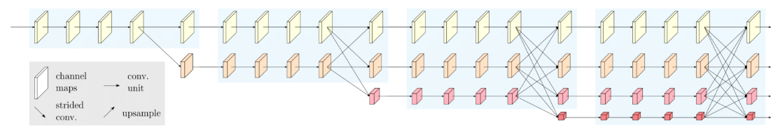
General Architecture
Institute of Systems Science, National University of Singapore
HRNet [7]
Four stages of the HRNet illustrates our proposed architecture
Start with a high-resolution convolution stream
Add high-to-low resolution convolution streams progressively
Connect the streams in parallel
Image taken from https://www.microsoft.com/en-us/research/blog/high-resolution-network-a-universal-neural-architecture-for-visual-recognition/

Slide 11
Scope of Work
Institute of Systems Science, National University of Singapore
Implement autonomous vehicular navigation, based on [1]
learning to use perception data to inform autonomous navigation; without the need for localization, mapping and planning
forming the basis for an intelligent navigation system to guide the vehicle during simulated navigation
Improve the latent representation of input images by substituting out the ResNet used in the encoder of CM-VAE and replacing it with one of the newer deep computer vision models.
(Optional) – Train the navigation policy in a simulated environment modelled after the actual deployment environment.

Slide 12
Our Contributions
Institute of Systems Science, National University of Singapore
This project has the potential to save business time and money, by using a simulated environment to train the autonomous vehicular systems prior to deployment.
Our ideas for the project aim to improve the performance of the systems described in [1], by incorporating state-of-the-art deep computer vision.

Slide 13
References
Institute of Systems Science, National University of Singapore
[1] R. Bonatti, R. Madaan, V. Vineet, S. Scherer, and A. Kapoor, “Learning visuomotor policies for aerial navigation using cross-modal representations,” arXiv preprint arXiv:1909.06993, 2020.
[2] S. Shah, D. Dey, C. Lovett, and A. Kapoor, “Airsim: High-fidelity visual and physical simulation for autonomous vehicles,” Field and Service Robotics, 2017. [Online]. Available: https://arxiv.org/abs/1705.05065
[3] E. Yurtsever, J. Lambert, A. Carballo, and K. Takeda, “A survey of autonomous driving: Common practices and emerging technologies,” arXiv preprint arXiv: 1906.05113, 2019.
[4] L. Tai, J. Zhang, M. Liu, J. Boedecker, and W. Burgard, “A survey of deep network solutions for learning control in robotics: From reinforcement to imitation,” arXiv preprint arXiv: 1612.07139, 2015.
[5] A. Loquercio, A. I. Maqueda, C. R. Del-Blanco, and D. Scaramuzza, “Dronet: Learning to fly by driving,” IEEE Robotics and Automation Letters, vol. 3, no. 2, pp. 1088-1095, 2018.
[6] G. Huang, Z. Liu, L. Maaten, and K. Q. Weinberger, “Densely connected convolutional networks,” In Proceedings of the IEEE conference on computer vision and pattern recognition, pp 4700-4708, 2017.
[7] B. Cheng, B. Xiao, J. Wang, H. Shi, T. S. Huang, and L. Zhang, “Bottom-up higher-resolution networks for multi-person pose estimation,” arXiv preprint arXiv: 1908.10357, 2019.

